Slide 1


Advanced Algorithm Assignment 6
12032189 Yuxi Liu

Slide 2
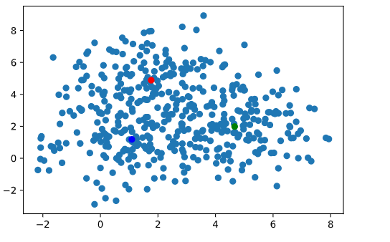
Exercise 6-1
Clearly demonstrate the effects of mon the clustering results by the fuzzy c-means algorithm through computational experiments on a test data set (i.e., create a test data set which can be used for clearly demonstrating the effects of m).
450 sites
3 centers
When the change distance of the three Centers is less than 0.01, we stop iteration.

Slide 3
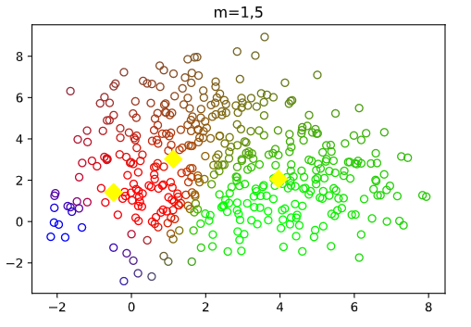
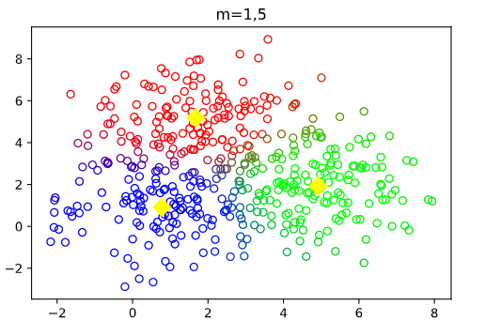
Exercise 6-1
Clearly demonstrate the effects of mon the clustering results by the fuzzy c-means algorithm through computational experiments on a test data set (i.e., create a test data set which can be used for clearly demonstrating the effects of m).
10 steps

Slide 4
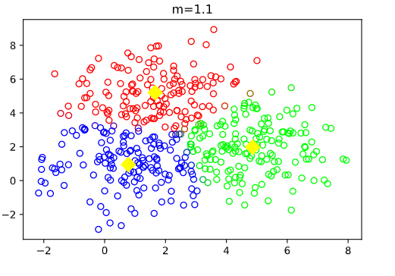
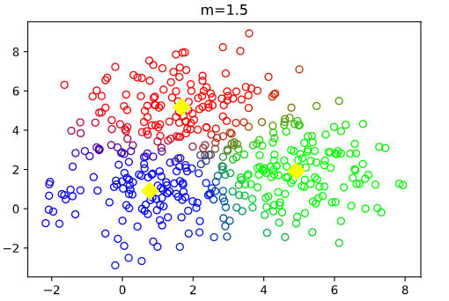
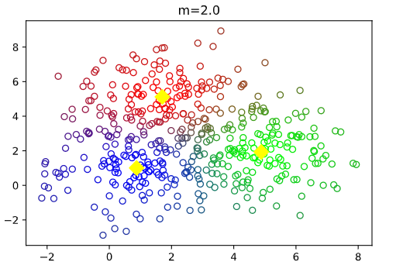
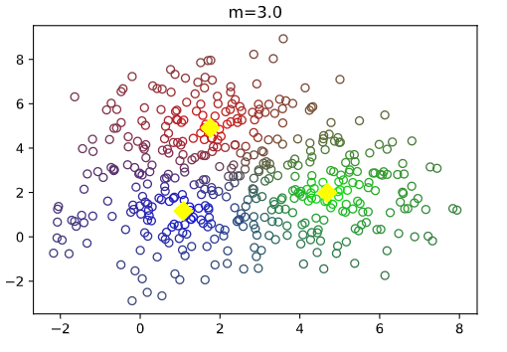
Exercise 6-1
10 steps
10 steps
The larger m
the more fuzzy of the boundary
13 steps
17 steps

Slide 5

Exercise 6-2
Clearly demonstrate the difference between the k-means algorithm and the fuzzy c-means algorithm through computational experiments on a test data set (i.e., create a test data set which can be used for clearly demonstrating the difference between the k-means algorithm and the fuzzy c-means algorithm).
12 steps
10 steps

Slide 6

THANK YOU

